Slide 1
2020W ESE 4009 TASK 1
HARDWARE REQUIREMENTS
Submitted by:
SURJEET SINGH
Group 10

Slide 2
CONTANTS
BEAGLE BONE BLACK
GSM MODULE
WIFI MODULE
LCD DISPLAY
OTHER COMPONENTS
REFERENCES

Slide 3
BEAGLE BONE bLACK WHY THis COMPONENTS?
Beagle Bone Black runs on Linux operating system, so it is not limited to only one or two programming language.
It has required UART, SPI, I2C interface in addition withIt has required UART, SPI, I2C and easy interface with other microcontroller like Arduino , raspberry pi..

Slide 4
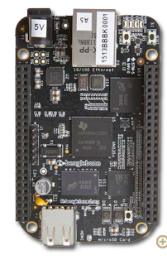
Beagle Bone Black
512MB DDR3 RAM
Operation Temperature – 0-70 degrees C.
Support 2*I2c, 4*Uart 1*USB, 12 PWM/timer,2*spi, interface protocols.
2 headers, each has 23 pins .
Audio and Video capes(add-on)
ARM Cortex-A8, 1GHz.
Operating Humidity – 20 – 90% (Non-Condensing
Power Supply – 5V/02A

Slide 5
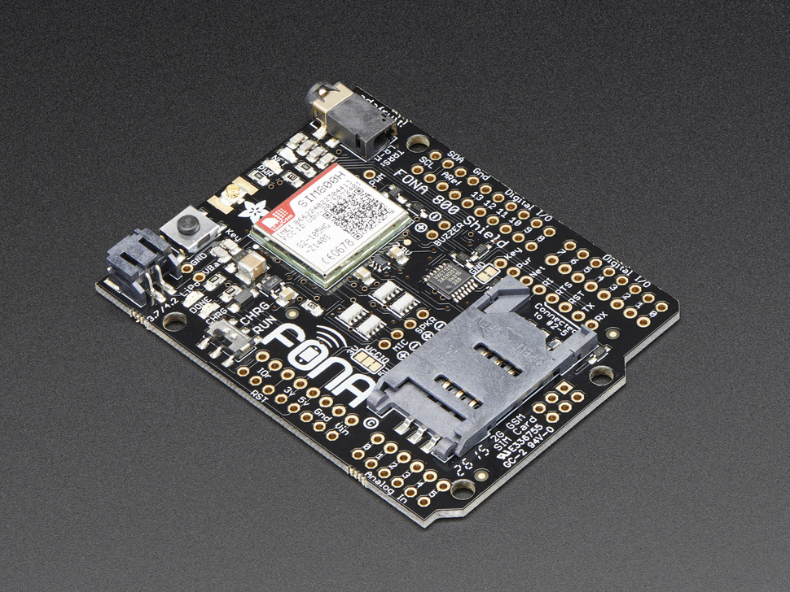
Why THIS COMPONENT? ADAFRUIT FONA 800 GSM MODULE
It supports the Canadian frequency bandwidth (850/1900 MHz).
Support any gsm sim with 2 g network.
Very tiny in size.
Support UART interface so required less number of wires.

Slide 6
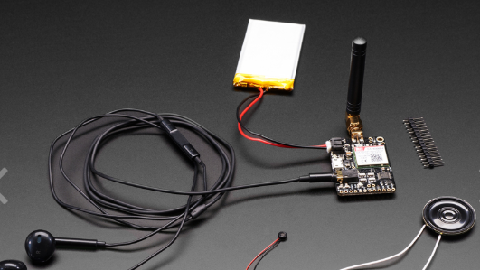
Adafruit fone 800 GSM
Quad-band 850/900/1800/1900 MHz
Make/Receive video calls using headset or an external 8ohm speaker + electret microphone
Send & receive SMS messages
GPRS signal transmission (TCP/IP, HTTP, etc.)
Requires 3v or 5v power supply with on-board charging circuit.
PWM/Buzzer vibrational motor contol
“auto-band” detection AT command interface

Slide 7
USB WI-FI module why this component?
It requires only 2.0 usb port for interface.
Network: Auto-switch to use 802.11n or 802.11g or 802.11b mode.
Integrated antenna and small in size.

Slide 8
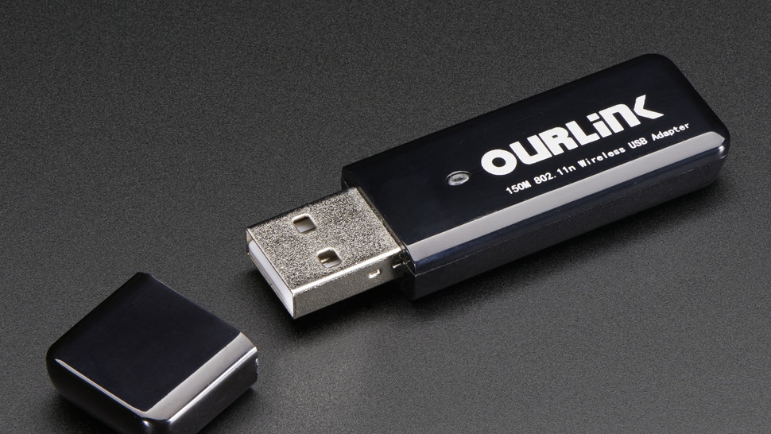
Wifi Module
This module is low cost and yet very simple.
Works great with 802.11b/g/n networks.
Power requirement is 5v,2A
Data Rate: 802.11n: up to 150Mbps (downlink) and up to 150Mbps (uplink) , 802.11g: 54 / 48 / 36 / 24 / 18/ 12 / 9 / 6 Mbps auto fallback, 802.11b: 11 / 5.5 / 2 / 1 Mbps auto fallback
RF Frequency: 2412 ~ 2462 MHz (North America), 2412 ~ 2472 MHz (Europe), 2412 ~ 2484 MHz (Japan)

Slide 9
ULTRASONIC SENSORS WHY THIS COMPONENT?
The working principal is based on sound reflection which works more accurately in dark areas as compared to IR sensors.
Their high frequency, sensitivity, and penetrating power make it easy to detect external or deep objects

Slide 10
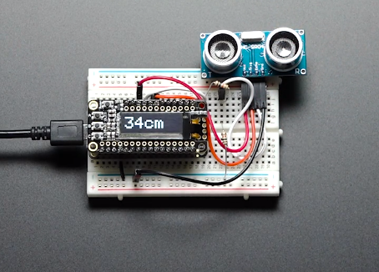
Ultrasonic Distance Sensor
This ubiquitous sensor is really common in robotic projects
They can be used for automations system.
They work at about 2cm to 400cm away
These sensors are fairly easy to use, and low cost
They require powering from 3v to 5V

Slide 11
4-DIGIT 7-SEGMENT DISPLAY
It comes with I2C backpack , reduces the number of wires used in interfacing.
Low cost.
Programming and interfacing is easy.

Slide 12
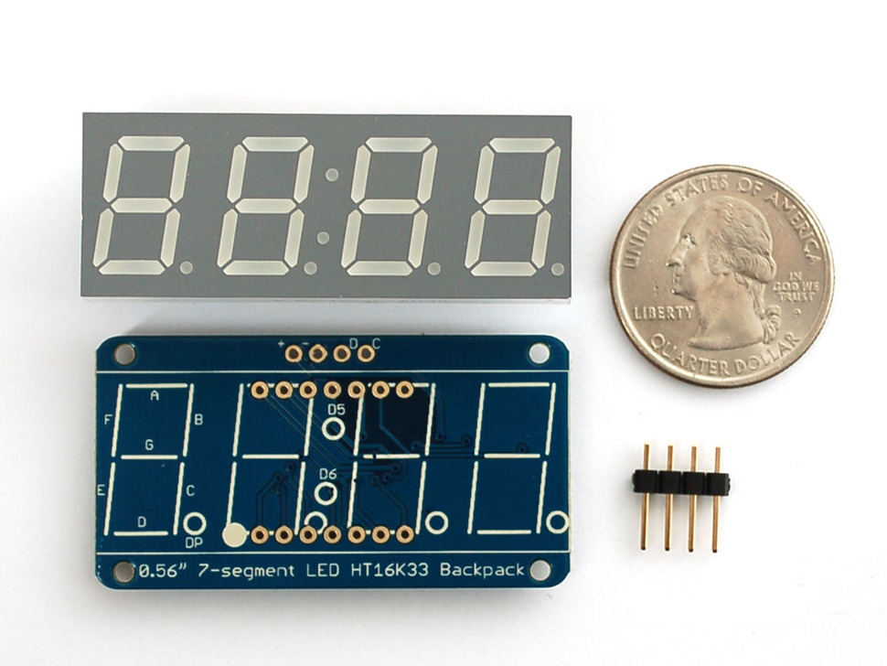
7-Segment Display
Adafruit 0.56, 8 Digit 7-Segment Display for Beagle Bone.
I2c interface.
Operating voltage 3.3v
4 Digit LED Display
Pins: VCC, GND, Dout, LOAD, Clk
Dimensions – 45 x 23 x 9 mm

Slide 13
Other requirements
5v ,2A DC power supply
2 Bread Boards
1 Box
Jumper Wires.

Slide 14
REFERENCES
adafruit.com. (n.d.). Retrieved from USB Wi Fi (802.11b/g/n) Module:
https://www.adafruit.com/product/1012
adafruit.com. (n.d.). Retrieved from Adafruit 0.56" 4-Digit 7-Segment Display w/I2C Backpack - RED:
https://www.adafruit.com/product/1270
adafruit.com. (n.d.). Retrieved from Setting up Wi Fi with Beagle Bone Black:
https://learn.adafruit.com/setting-up-wifi-with-beaglebone-black?view=all
Retrieved from Adafruit FONA 800
https://www.adafruit.com/product/2468
Ultrasonic Sensors: Advantages and Limitations. (n.d.). Retrieved from maxbotix.com
https://www.maxbotix.com/articles/advantages-limitations-ultrasonic-sensors.htm/

